Slide 1

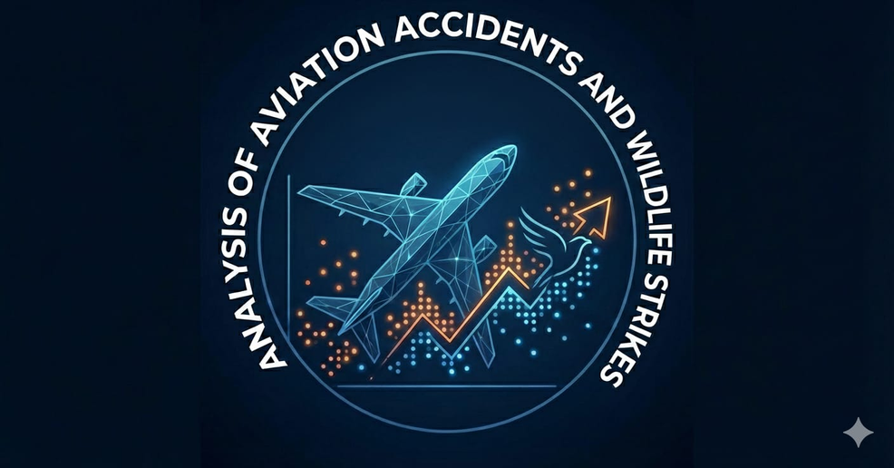

Data Analysis Track
Project Title
Analysis of Aviation Accidents and Wildlife Strikes
Represented by : Group (#2)
Under Supervision of : DR. Amal Mahmoud

Slide 2

Group
members
Akram Mohamed El-Hady
Ehab Tharwat Mohamed
Mahmoud Ahmed Hefnawy
Nourhan NasrEldin Mohamed
Taghreed Roshdy Ahmed
Ahmed Mohamed Ismail

Slide 3


Agenda
1.Introduction
2.Data Source & Structure
3.Data Preprocessing
4.Data Modeling
5.Data Analysis by SQL
6.Data Analysis by Tableau
7.Data Analysis by Python
8.Data Analysis by Excel
9.Data Analysis by PowerPi

Slide 4
1.Introduction
Aviation accidents and bird strikes are major safety concerns in air transportation. Despite advances in aircraft technology, bird strikes—especially during takeoff and landing—can cause engine damage, windshield penetration, or loss of control. Analyzing these incidents helps improve safety measures, risk assessment, and preventive strategies in aviation operations.

Slide 5



2. Data Source
Our analysis utilizes two major U.S. aviation datasets: the National Transportation Safety Board (NTSB) Aircraft Accident Database and the Federal Aviation Administration (FAA) Wildlife Strike Database. Together, these datasets, containing more than 300,000 Records and spanning the period from 1996 to 2025, provide a comprehensive foundation for analyzing trends in aircraft accidents and wildlife-related hazards.
https://www.ntsb.gov/
https://www.faa.gov/data

Slide 6

3.Data Preprocessing
A-Data Cleaning
B-Filling Missed Values
Missing values were filled using appropriate imputation methods to maintain dataset completeness and integrity.
Data cleaning involved correcting errors, and standardizing formats to ensure accurate and consistent analysis.

Slide 7


Data Preprocessing by
SQL
SQL was empolyed for Data Preprocessing Step and data preparation.

Slide 8


4.Data Modeling
Data modeling was carried out to organize both the FAA Wildlife Strike data and the NTSB Aircraft Accident data into structured analytical models. This included defining relationships between incident attributes such as event date, location, aircraft type, phase of flight, and damage level. The modeling process also involved standardizing variable formats across the two datasets, linking common fields (e.g., aircraft category, airport code), and selecting relevant features from more than 300,000 records. This ensured consistent querying, accurate trend analysis, and clear visualization of accident patterns and wildlife-related hazards.

Slide 9
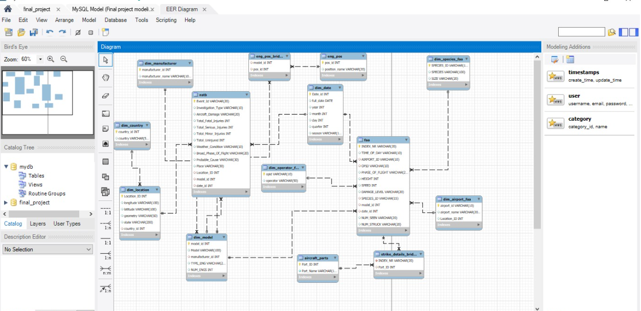
4.Data Modeling

Slide 10
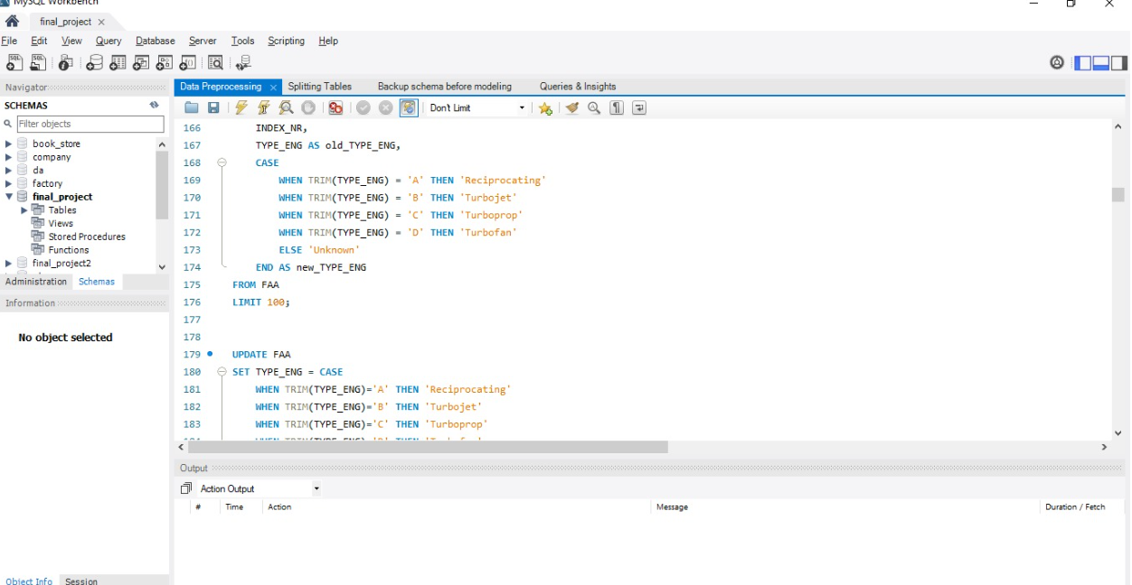

5.Data Analysis by SQL

Slide 11
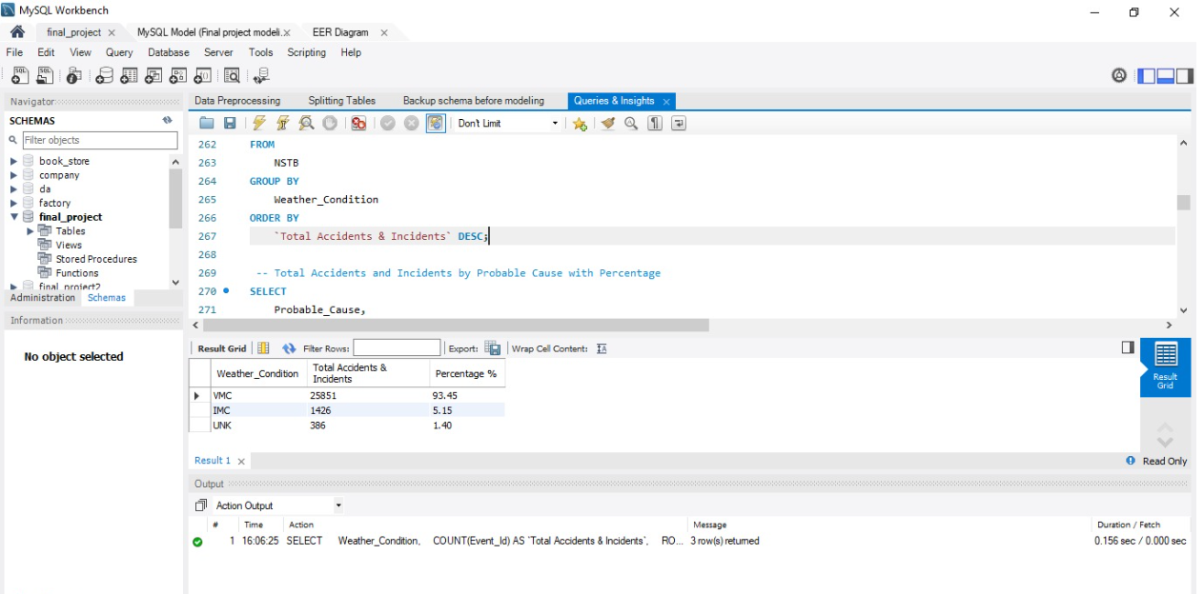
5.Data Analysis by SQL

Slide 12
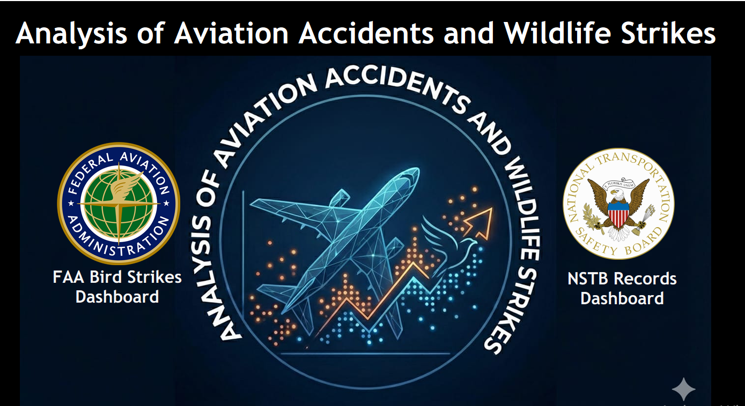

6.Data Analysis by Tableau

Slide 13
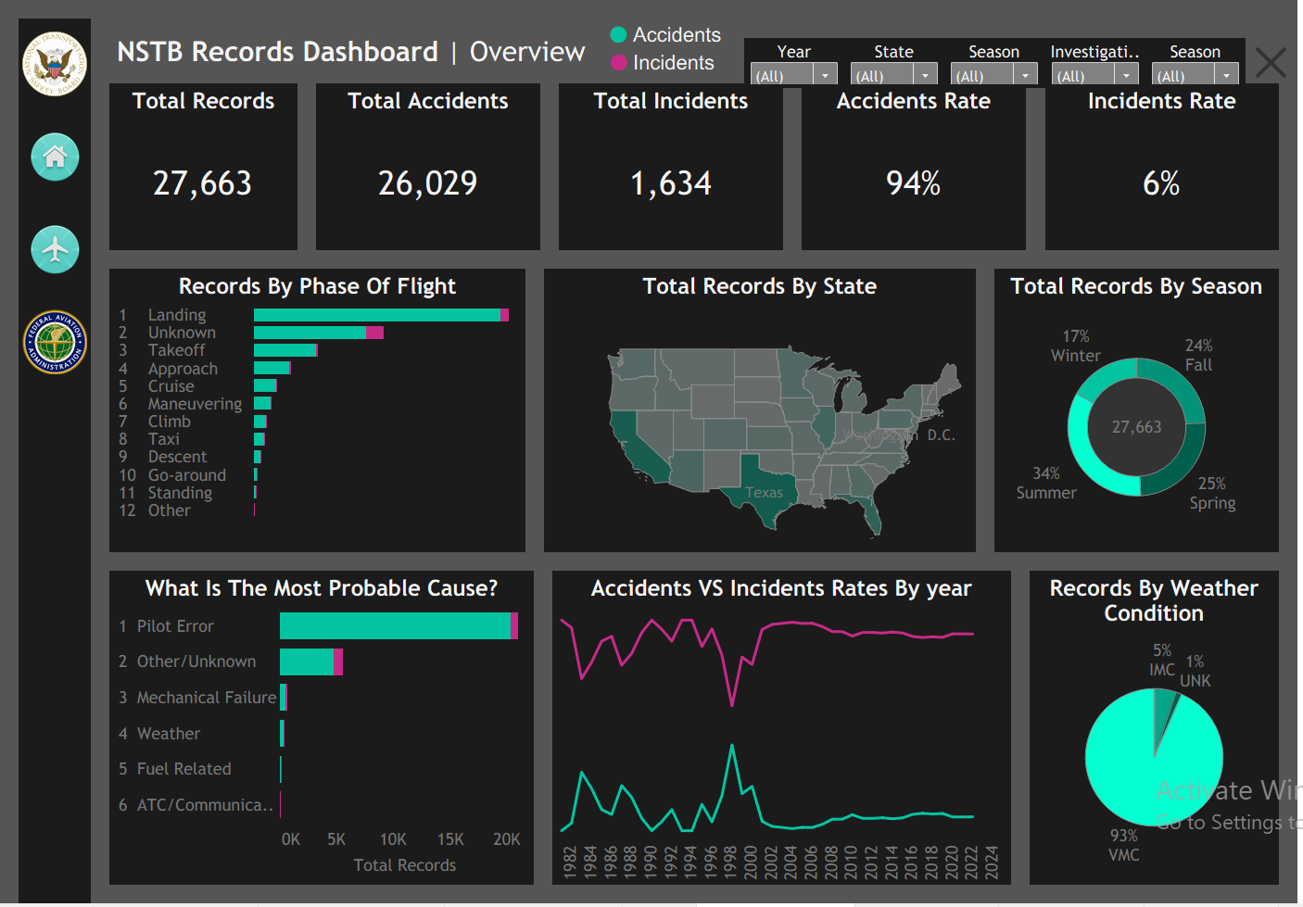
6.Data Analysis by Tableau

Slide 14
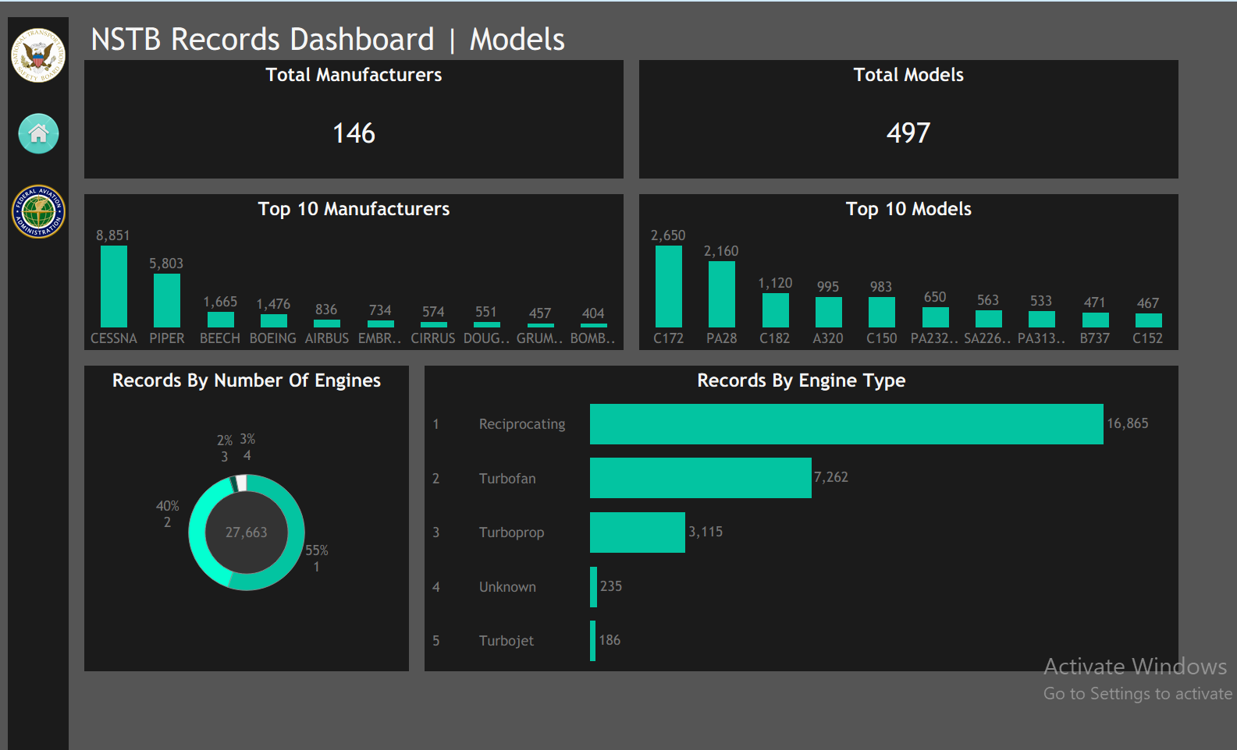
6.Data Analysis by Tableau

Slide 15
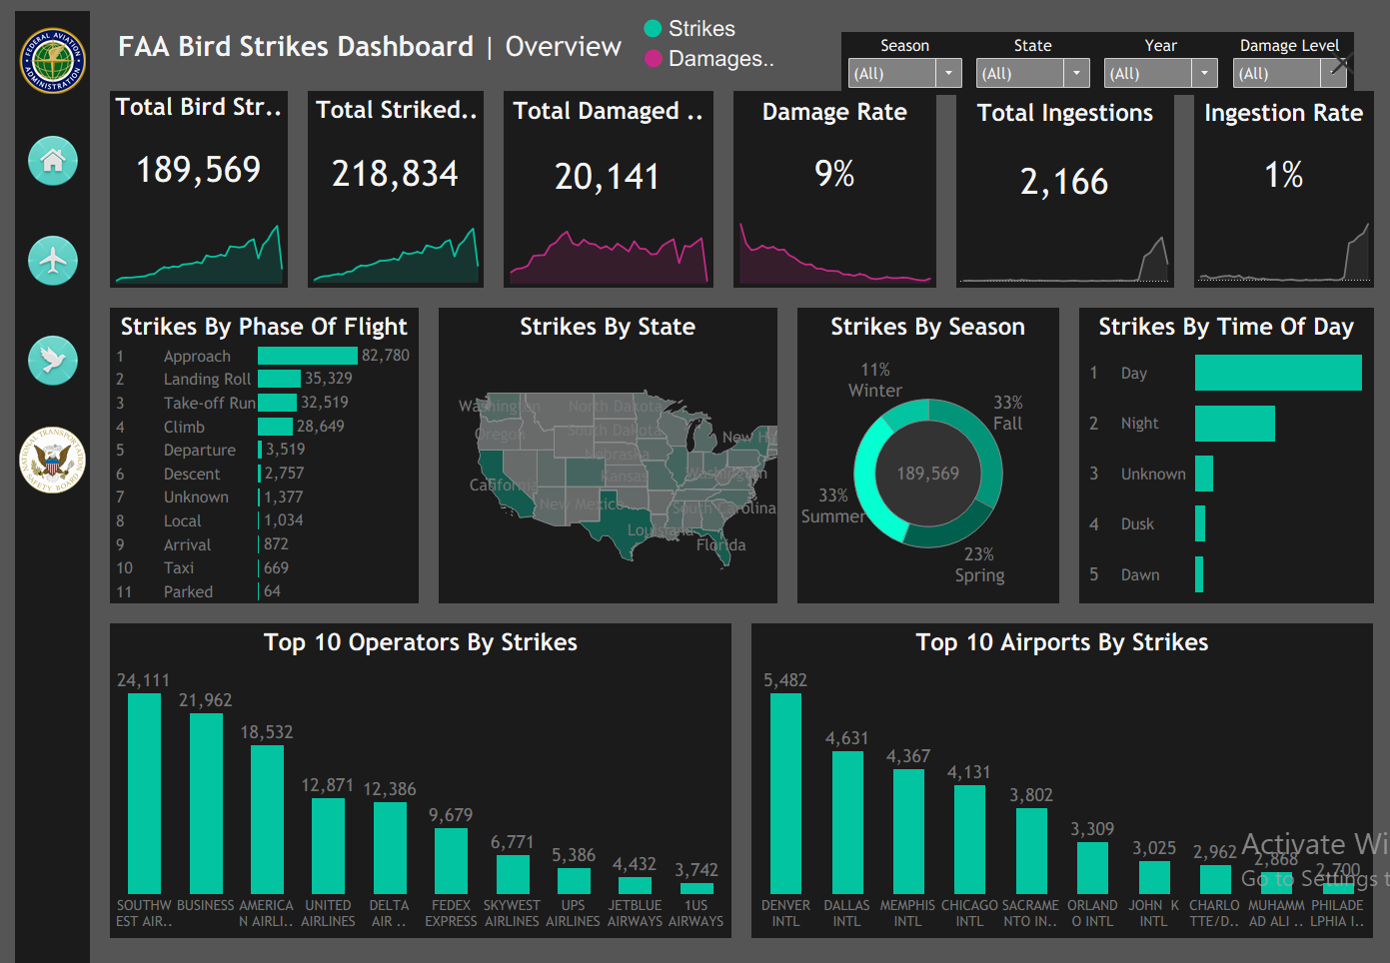
6.Data Analysis by Tableau

Slide 16
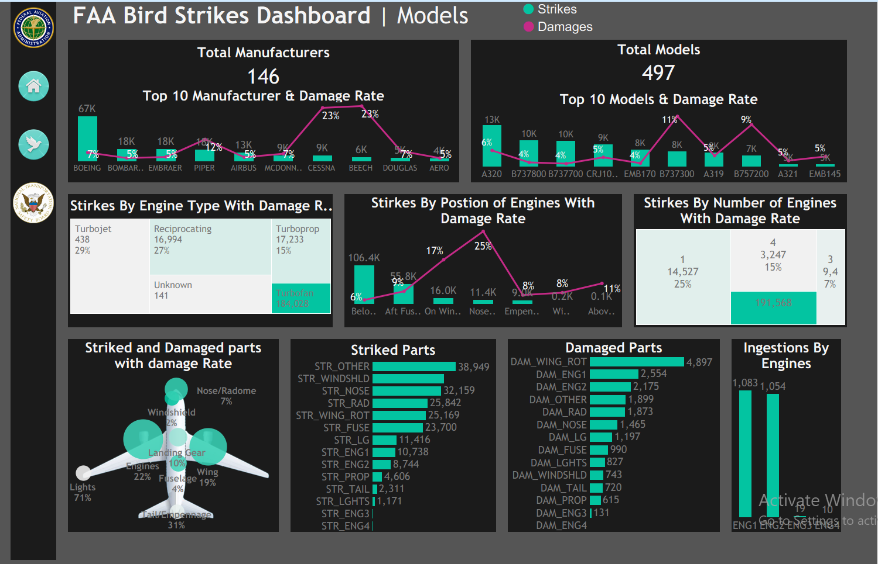
6.Data Analysis by Tableau

Slide 17
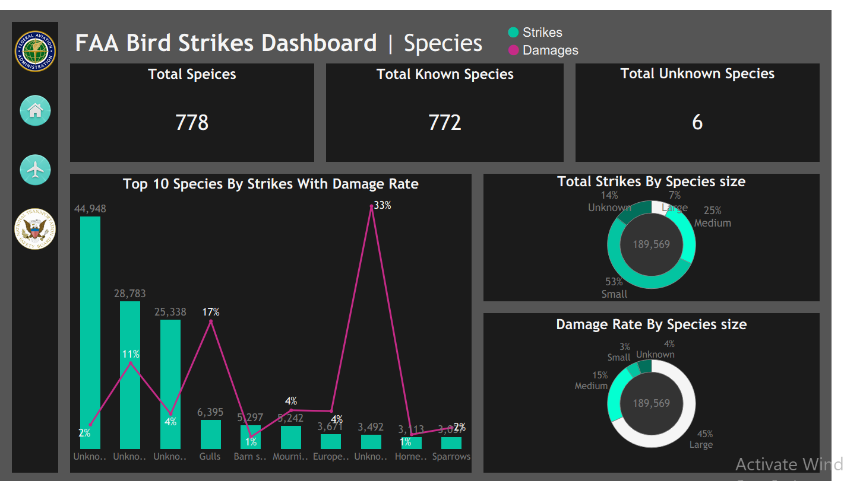
6.Data Analysis by Tableau

Slide 18
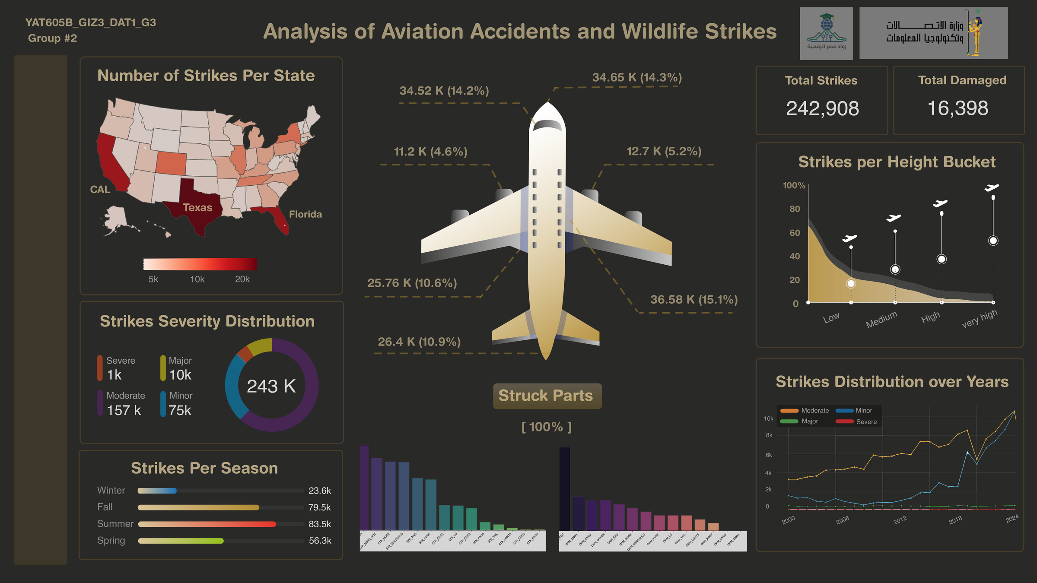

7.Data Analysis by Python

Slide 19
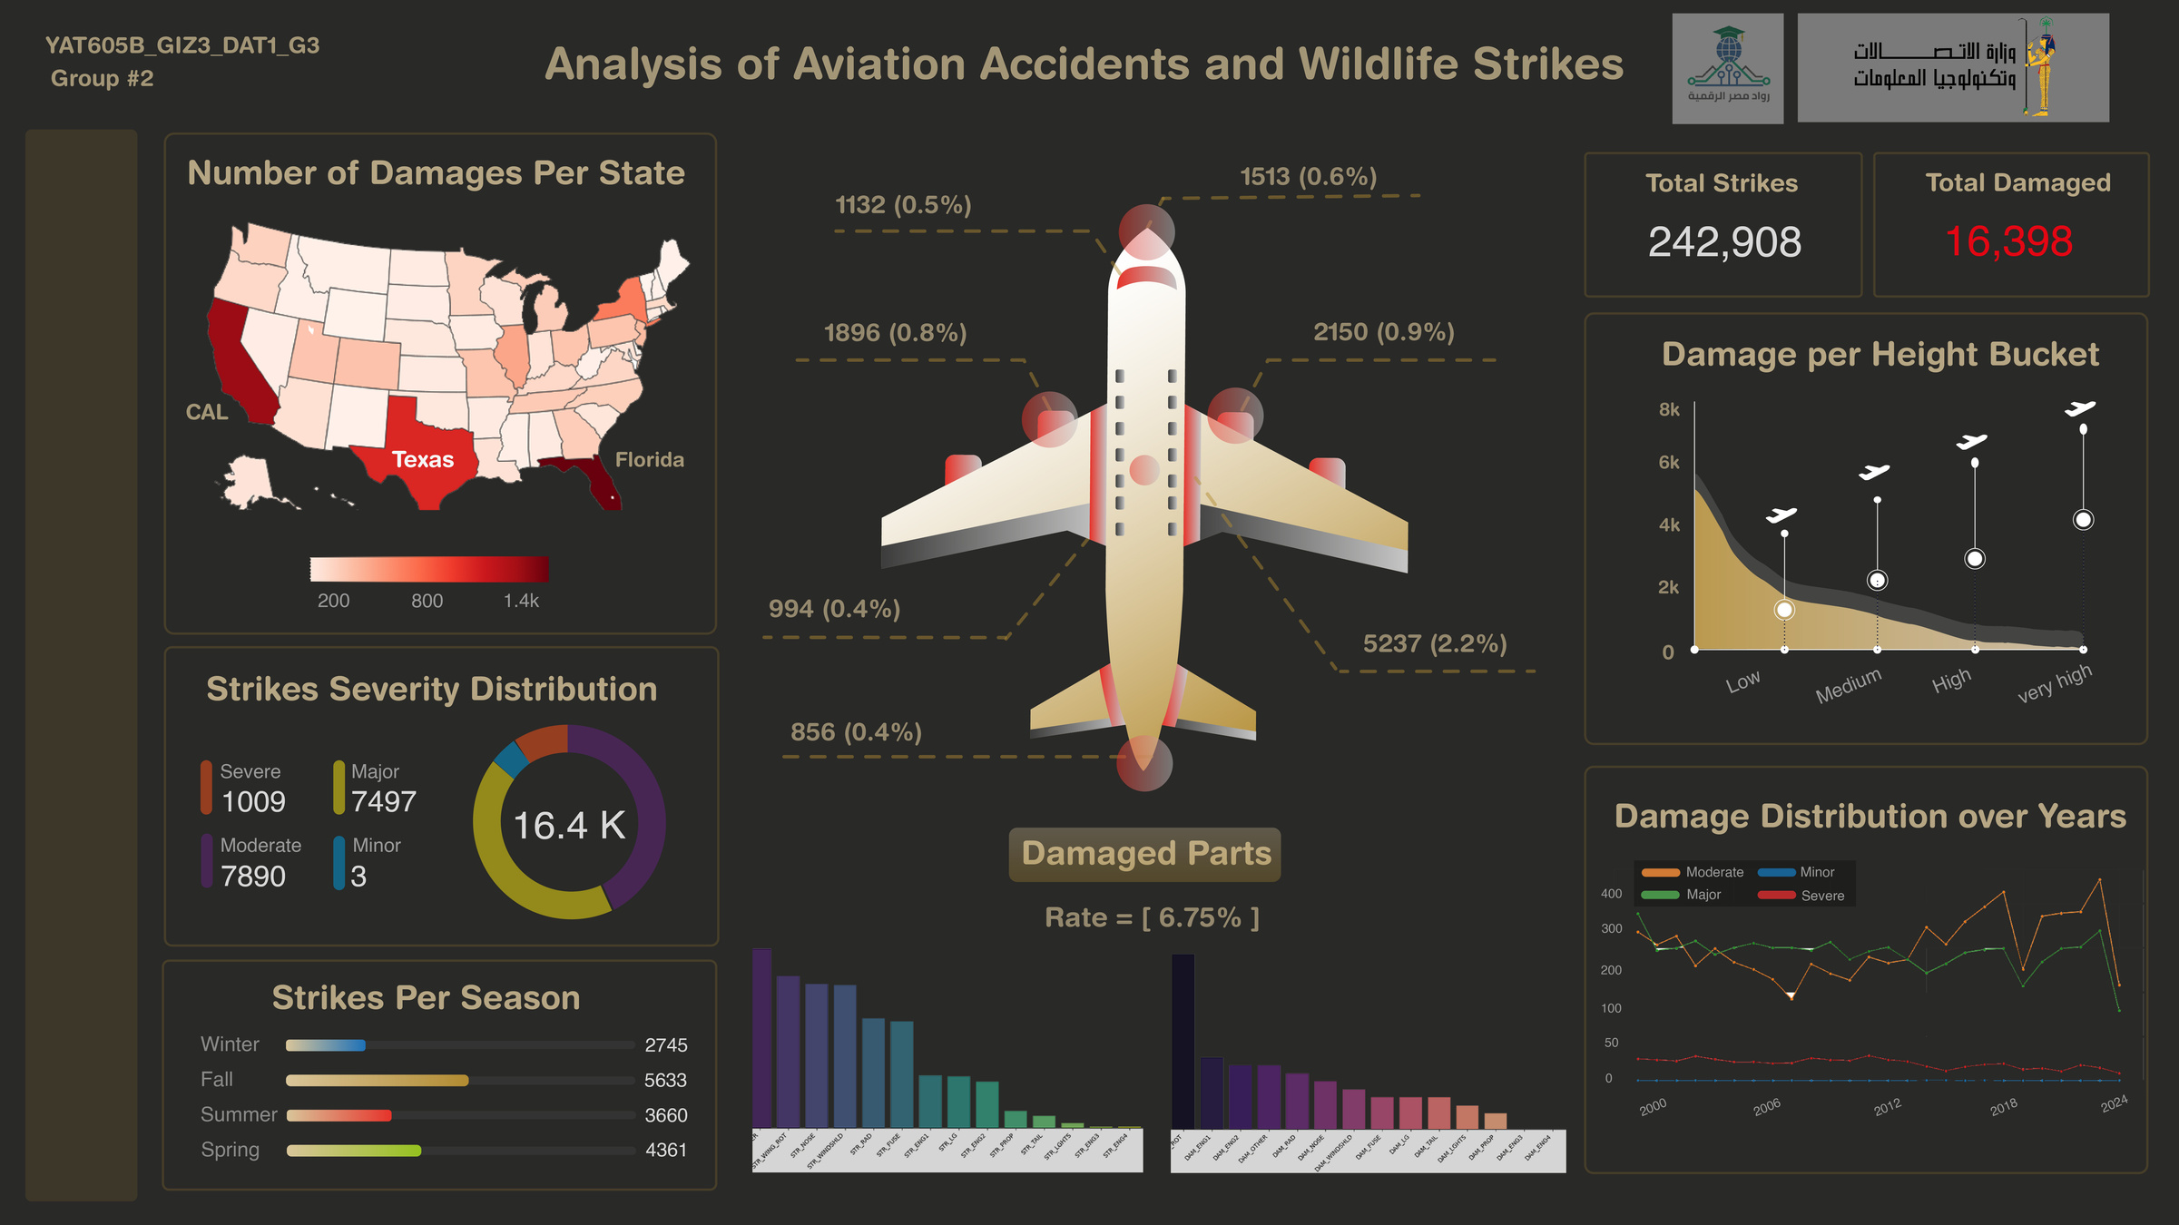
7.Data Analysis by Python

Slide 20
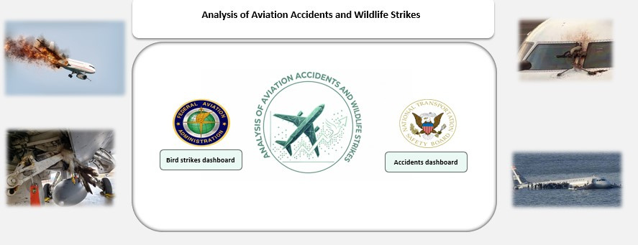

8.Data Analysis by Excel

Slide 21
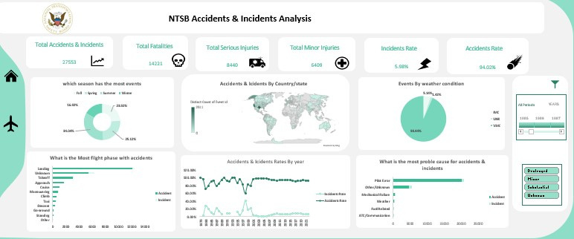
8.Data Analysis by Excel

Slide 22
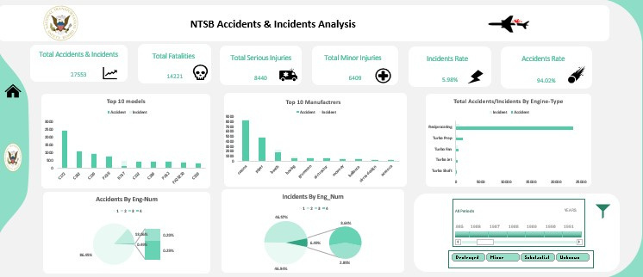
8.Data Analysis by Excel

Slide 23
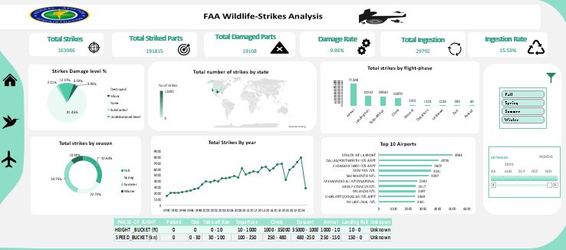
8.Data Analysis by Excel

Slide 24
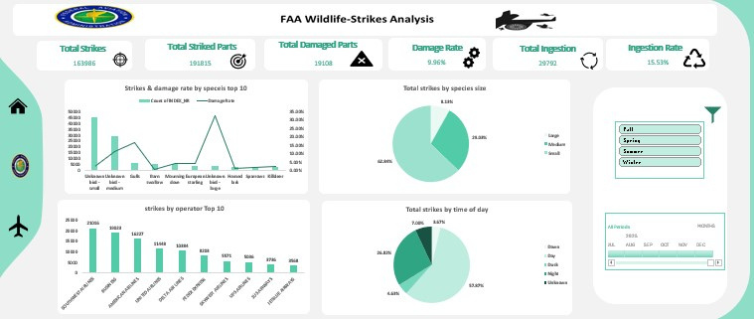
8.Data Analysis by Excel

Slide 25
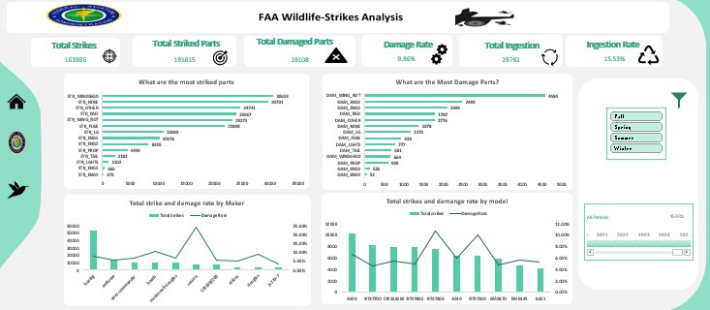
8.Data Analysis by Excel

Slide 26
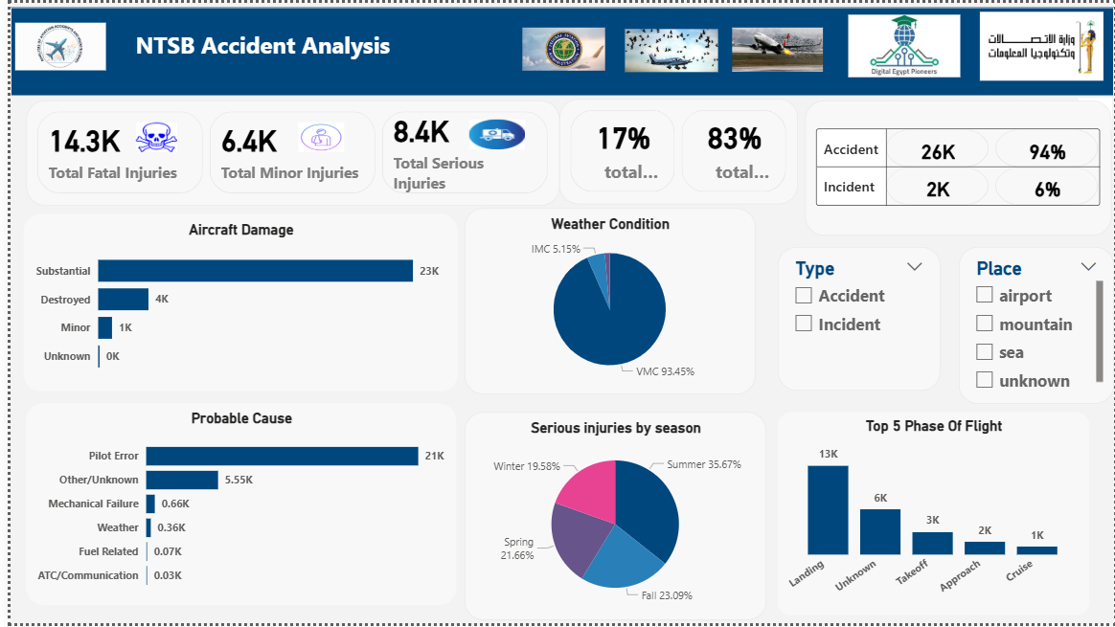

9.Data Analysis by Power bi

Slide 27
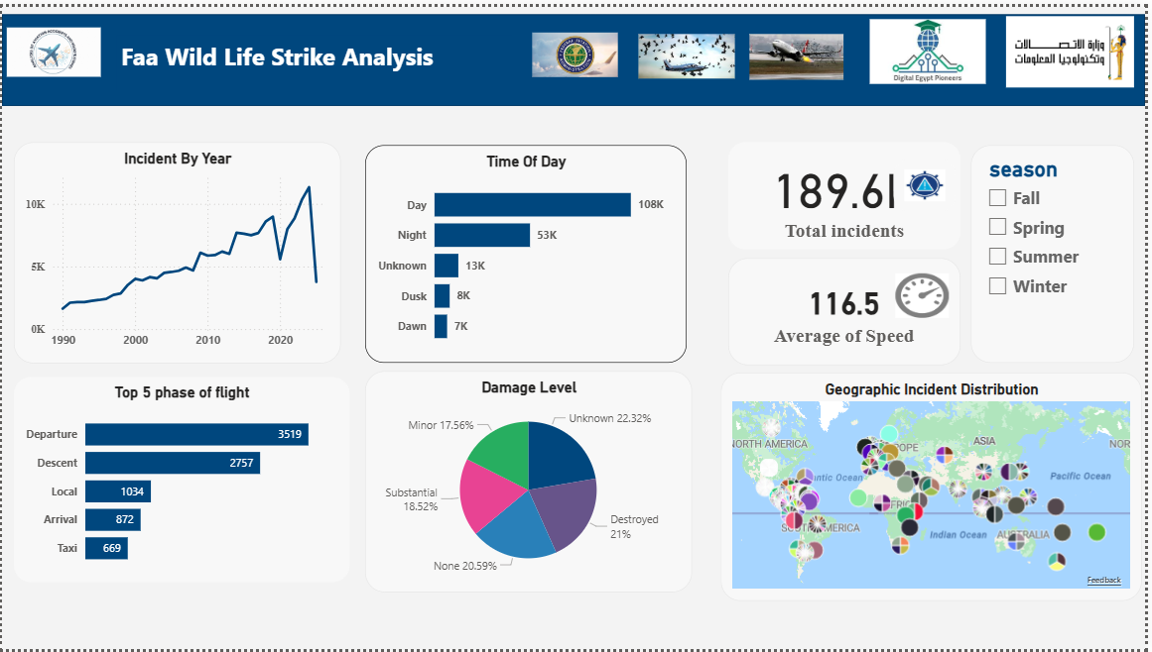
9.Data Analysis by Power bi

Slide 28
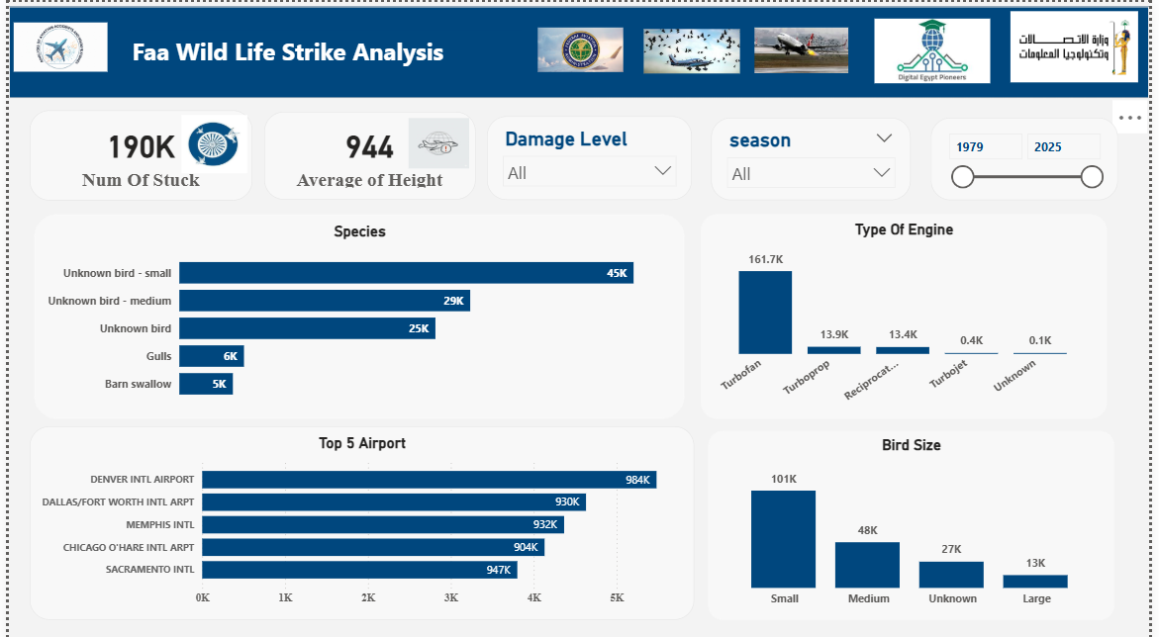
9.Data Analysis by Power bi

Slide 29

Recommendations and Further Analysis
1-Seasonal Preparedness
2-Operator-Focused Measures
3-Aircraft Model Monitoring
4-Airport Risk Mitigation
5-Species Control
6-Maintenance & Resilience

Slide 30

Acknowledgement
The team members would like to express their sincere gratitude to the Digital Egypt Pioneers Initiative (DEPI) for their valuable support throughout this work.
The team also extends its heartfelt appreciation to Dr. Amal Mahmoud, our technical instructor, for her guidance, expertise, and continuous support.
The team would also like to acknowledge YAT for providing a supportive training environment that contributed to the success of this project.

Slide 31
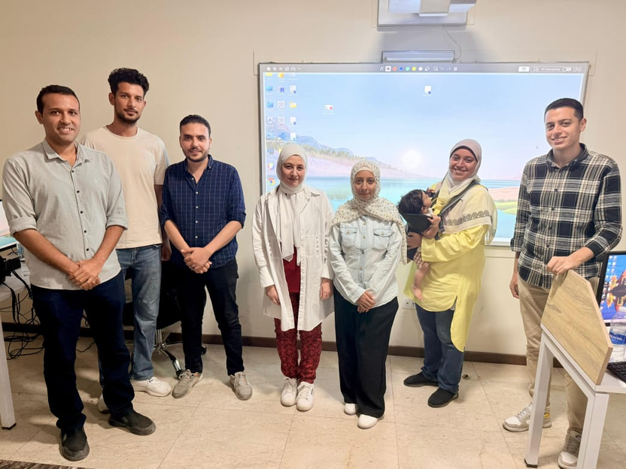

Thanks for attention

